Slide 1
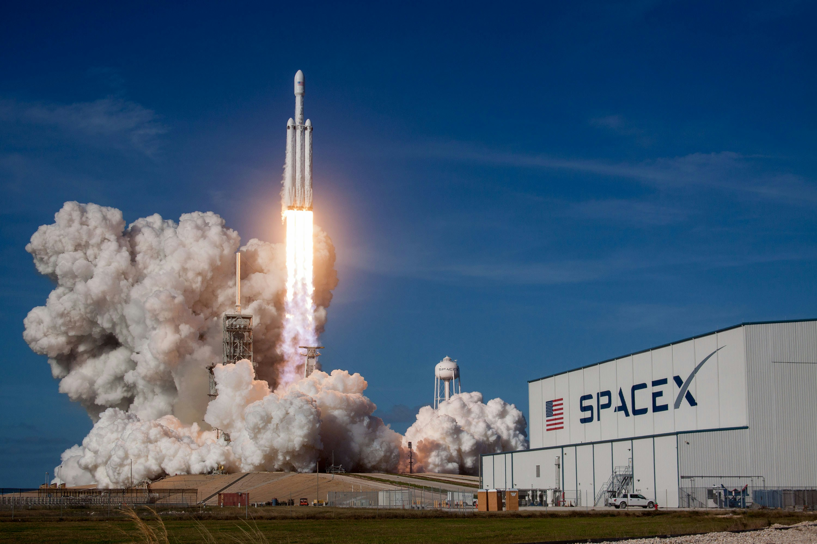


APPLIED DATA SCIENCE CAPSTONE
MUBASHIRALI
June 14, 2025
Founder Code with Bismillah

Slide 2
OUTLINE
Executive Summary
Introduction
Methodology
Results
Conclusion
Appendix

Slide 3

EXECUTIVE SUMMARY
In this Applied Data Science capstone project, I took on the exciting challenge of predicting whether the SpaceX Falcon 9 first stage would successfully land or not a real-world scenario that merges the thrill of space exploration with the power of data science.
My journey began with gathering and preparing the launch data cleaning it, organizing it, and shaping it into a form that could actually "speak" to us. Then, through exploratory data analysis (EDA), I dug deep into patterns and trends hidden in the numbers.
Using interactive visualizations, I was able to not just analyze, but truly understand how different factors like payload mass, orbit type, or booster version might impact the rocket's success or failure.
Finally, I applied multiple machine learning algorithms to make predictions. Among them, the Decision Tree model stood out, providing the most reliable results in predicting whether a rocket would safely land back or not.
This project not only improved my technical skills but also gave me a taste of how data science can be used to decode the mysteries of the universe quite literally.

Slide 4
INTRODUCTION
In this capstone, we will predict if the Falcon 9 first stage will land successfully. SpaceX advertises Falcon 9 rocket launches on its website with a cost of 62 million dollars; other providers cost upward of 165 million dollars each, much of the savings is because SpaceX can reuse the first stage. Therefore if we can determine if the first stage will land, we can determine the cost of a launch. This information can be used if an alternate company wants to bid against SpaceX for a rocket launch.
Most unsuccessful landings are planned. Sometimes, SpaceX will perform a controlled landing in the ocean.
The main question that we are trying to answer is, for a given set of features about a Falcon 9 rocket launch which include its payload mass, orbit type, launch site, and so on, will the first stage of the rocket land successfully?

Slide 5
METHODOLOGY
The Complete Methodology includes:
Data collection, wrangling, and formatting:
SpaceX API
Web scraping
Exploratory data analysis (EDA):
Pandas and NumPy
SQL
Data visualization, using:
Matplotlib and Seaborn
Folium
Dash
Machine learning prediction:
Logistic regression
Support vector machine (SVM)
Decision tree
K-nearest neighbors (KNN)
Wikipedia
SpaceX API
requests
BeautifulSoup
JSON Response
HTML Tables
Normalize & Parse
Pandas DataFrame
Combine + Clean → Final Dataset

Slide 6
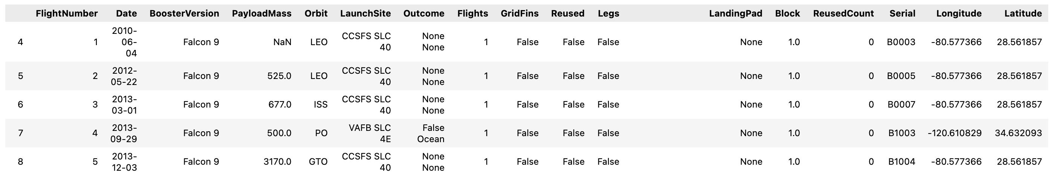
Data collection, wrangling, and formatting
SpaceX API
The API used in the capstone project was provided by Coursera: https://api.spacexdata.com/v4/rockets/
We used the SpaceX API to get data about different rocket launches. But since our project is only about Falcon 9, we filtered the data to include only Falcon 9 launches.
Some columns had missing values, so we filled those with the average (mean) of that column.
In the end, our cleaned dataset had 90 rows (launch records) and 17 columns (features). Below is a preview of the dataset after cleaning.

Slide 7

Data collection, wrangling, and formatting
Web Scraping
The data used was scraped from https://en.wikipedia.org/w/index.php?title=list_of_falcon_9_and_falcon_heavy_launches&oldid=1027686922
The website provides data specifically related to Falcon 9 launches only.
After processing the data, we obtained a final dataset with 121 rows (records) and 11 columns (features). The table below displays the first few entries of this dataset:

Slide 8
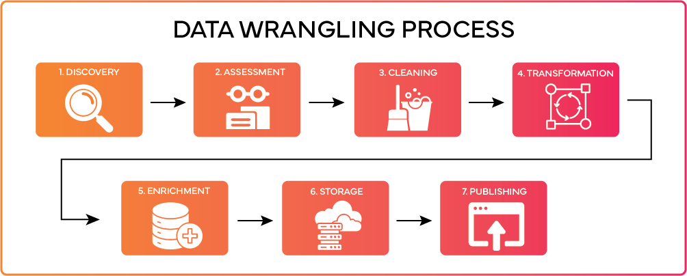
Data collection, wrangling, and formatting
Next, the data was cleaned to remove any missing values, and all categorical features were converted into numerical form using one-hot encoding.
We also added a new column called ‘Class’, which indicates the outcome of each launch — where ‘0’ means the launch failed, and ‘1’ means it was successful.
After this processing, the final dataset contained 90 rows (launches) and 83 columns (features)

Slide 9
Exploratory Data Analysis (EDA)
Pandas & NumPy Analysis
We used functions from Pandas and NumPy libraries to explore and understand the dataset. Some of the insights we extracted include:
How many launches took place at each launch site
How often each orbit type was used
The count and types of different mission outcomes
SQL-Based Exploration
Using SQL queries, we explored the dataset further to answer key questions such as:
What are the unique launch sites in the dataset?
How much total payload mass was launched by NASA (CRS) missions?
What is the average payload mass for the booster version F9 v1.1?

Slide 10
Data Visualization
Matplotlib and Seaborn
We used Matplotlib and Seaborn to create different types of plots like scatter plots, bar charts, and line charts etc.
These visualizations helped us understand key relationships in the data, such as:
How launch site varies with flight number
How payload mass is distributed across launch sites
How orbit type is related to success rate of launches
Interactive Mapping with Folium
Folium was used to create interactive maps for deeper spatial understanding.
With Folium, we were able to:
Plot all launch sites on a map
Highlight which launches were successful or failed at each site
Show distances from launch sites to nearby locations like cities, highways, and railways

Slide 11
Data Visualization
3. Interactive Dashboard with Dash
We used Dash to build an interactive web dashboard where users can explore the data using a dropdown menu and a range slider.
The dashboard includes:
A pie chart that shows the total number of successful launches from each launch site
A scatter plot that reveals the relationship between payload mass and mission outcome (success or failure) for different launch sites

Slide 12
Machine Learning Prediction
We used the Scikit-learn library to build and evaluate multiple machine learning models. The entire prediction process followed these key steps:
Standardized the data for better model performance
Split the dataset into training and testing sets
Trained four different models:
Logistic Regression
Support Vector Machine (SVM)
Decision Tree
K-Nearest Neighbors (KNN)
Fitted each model on the training data
Tuned hyperparameters to find the best settings for each model
Evaluated performance using:
Accuracy scores
Confusion matrix for each model

Slide 13
RESULTS
The results of our analysis are divided into five main sections:
EDA using SQL
EDA using Matplotlib & Seaborn visualizations
Interactive maps using Folium
Interactive dashboard using Dash
Predictive analysis using machine learning models
Throughout all the charts and graphs:
Class 0 indicates a failed launch
Class 1 indicates a successful launch

Slide 14
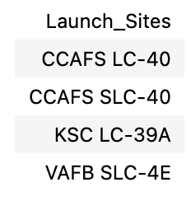
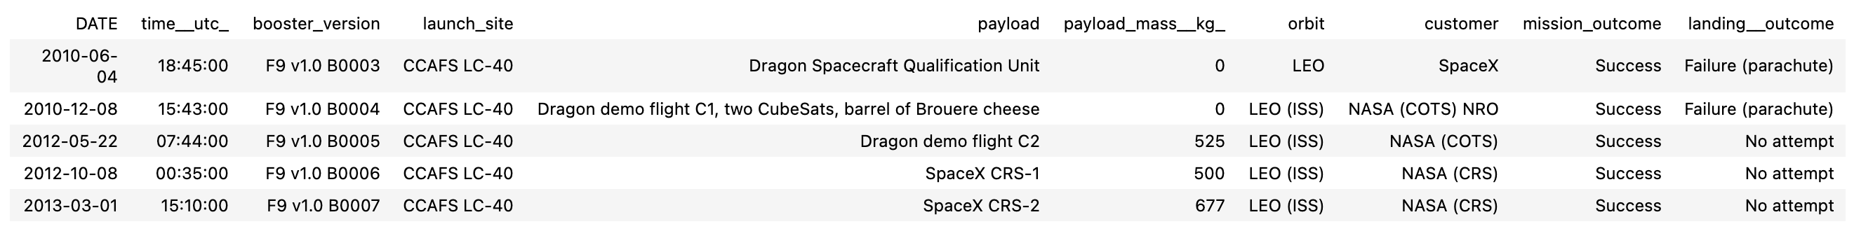
Exploratory Data Analysis (EDA) using SQL
We retrieved the names of all unique launch sites involved in the SpaceX missions to understand how many different sites were used.
Then, we filtered the data to show only those launch sites that begin with 'CCA' revealing 5 specific records matching this condition.

Slide 15
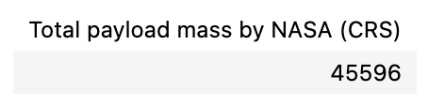
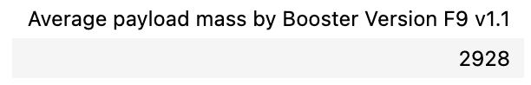
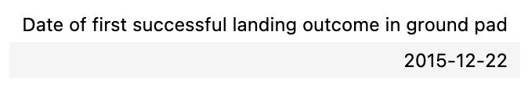
Exploratory Data Analysis (EDA) using SQL
Total payload mass transported by boosters for NASA (CRS) missions
Mean payload mass delivered by the F9 v1.1 booster version
The date on which the first successful landing on a ground pad was recorded

Slide 16
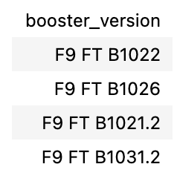
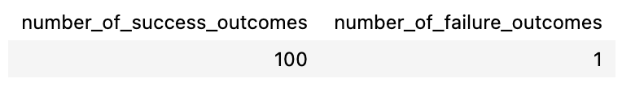
Exploratory Data Analysis (EDA) using SQL
Names of boosters that successfully landed on a drone ship and carried a payload between 4000 kg and 6000 kg
Total count of missions categorized by success and failure outcomes

Slide 17
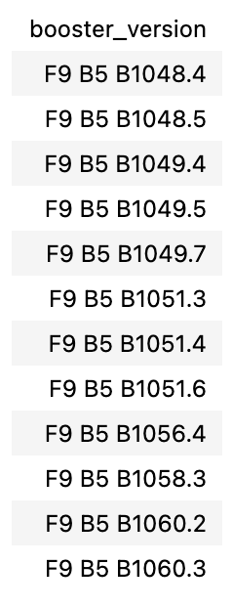
Exploratory Data Analysis (EDA) using SQL
List of booster versions with the maximum recorded payload capacity

Slide 18
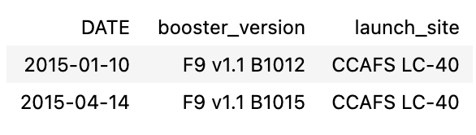
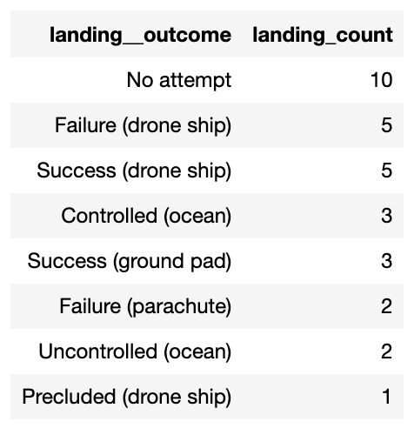
Exploratory Data Analysis (EDA) using SQL
Booster versions, launch site names, and failed drone ship landings that occurred during the year 2015
Number of landing outcomes recorded between June 4, 2010, and March 20, 2017, sorted in descending order

Slide 19
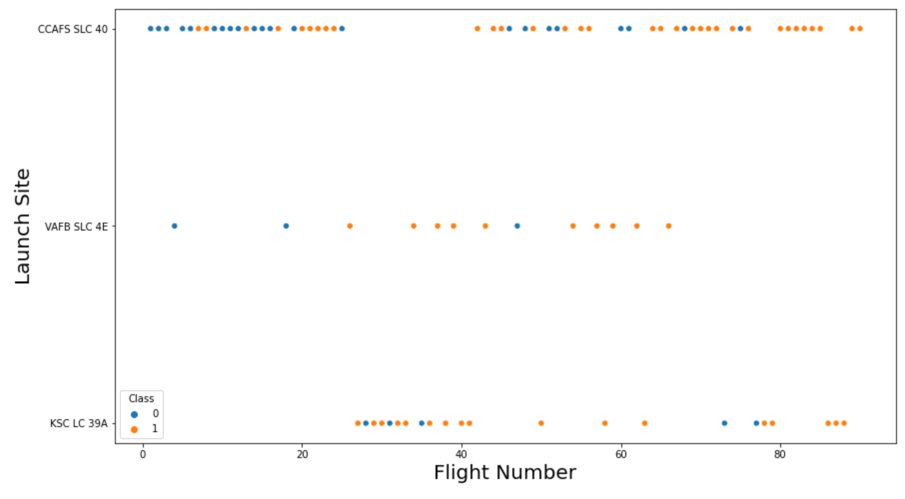
Matplotlib and Seaborn (EDA with Visualization)
Analyzing how flight numbers vary across different launch sites

Slide 20
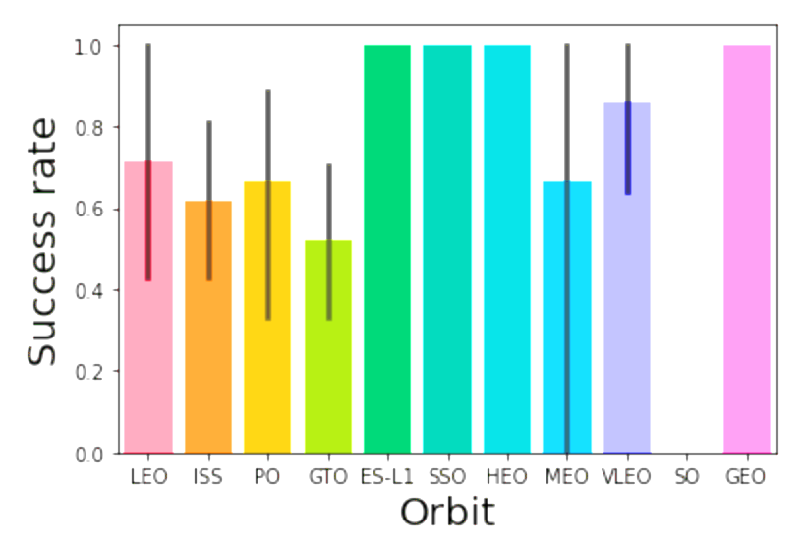
Matplotlib and Seaborn (EDA with Visualization)
Analyzing the link between mission outcome success and the type of orbit used

Slide 21
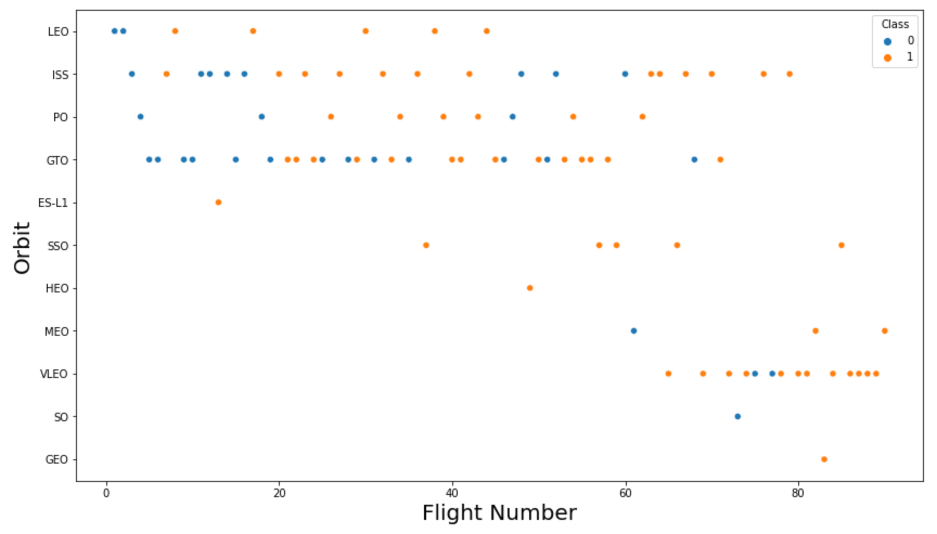
Matplotlib and Seaborn (EDA with Visualization)
Analyzing how orbit types are distributed across different flight numbers

Slide 22
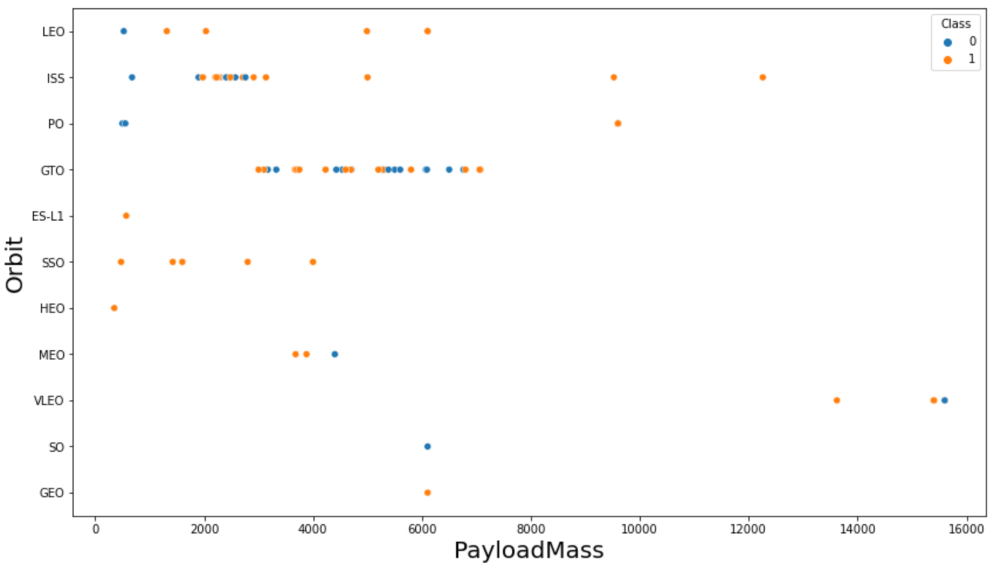
Matplotlib and Seaborn (EDA with Visualization)
Analyzing the connection between the weight of the payload and the orbit targeted

Slide 23
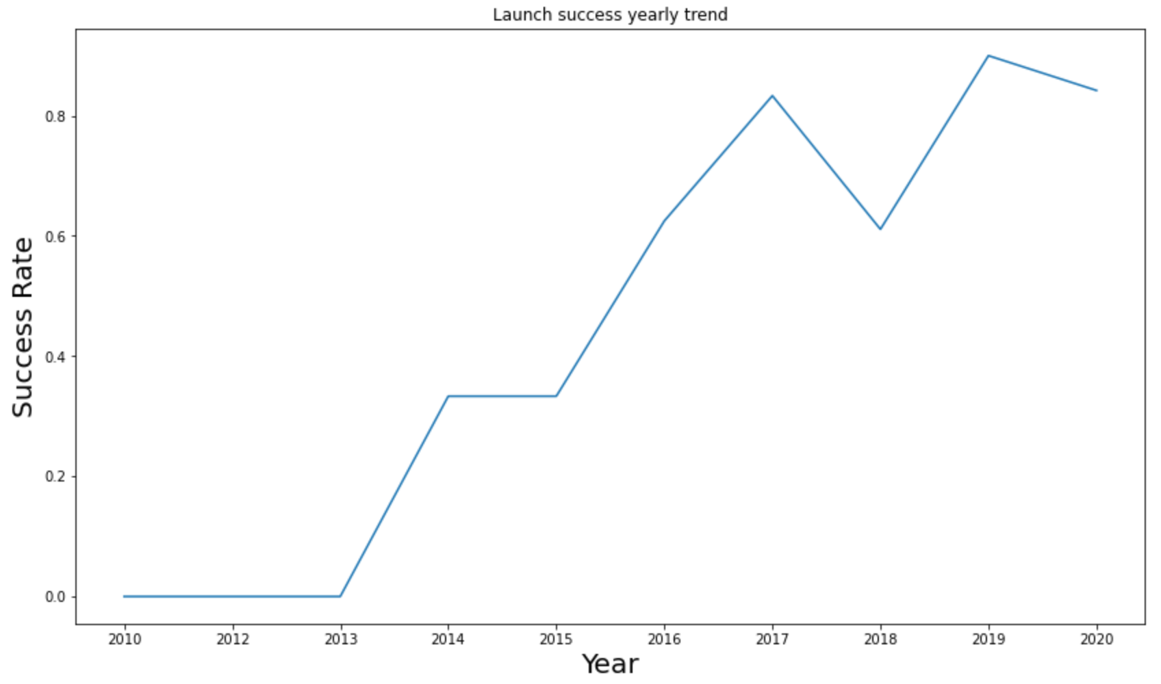
Matplotlib and Seaborn (EDA with Visualization)
The launch success yearly trend

Slide 24
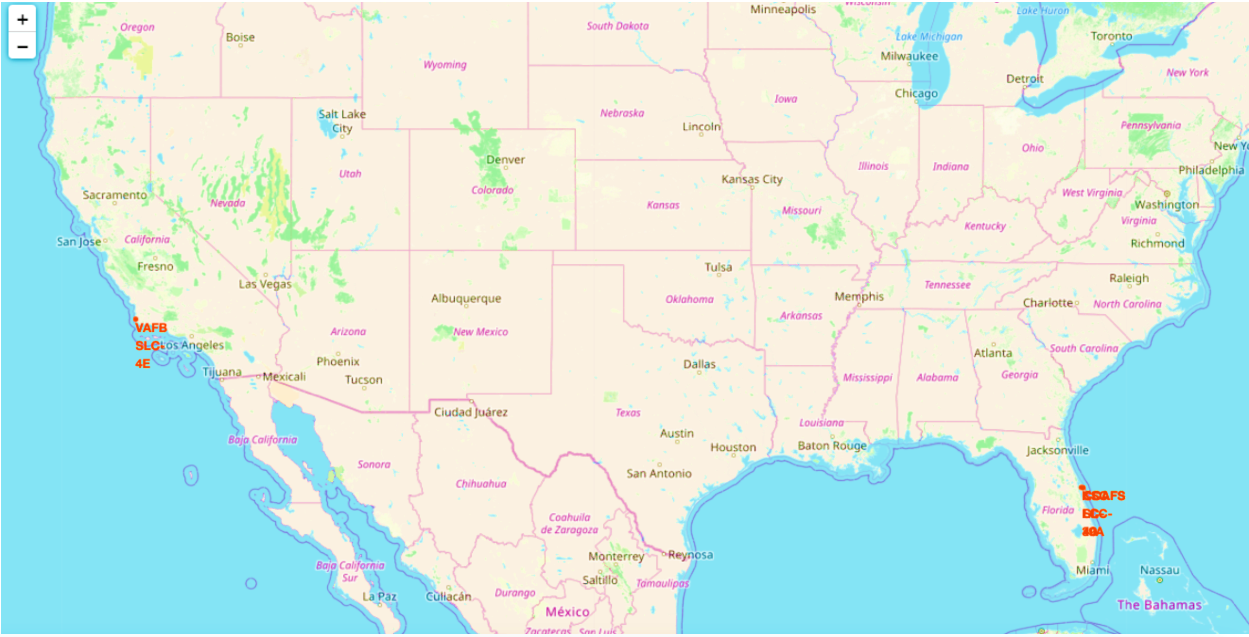
FOLIUM
All the launch sites on map

Slide 25
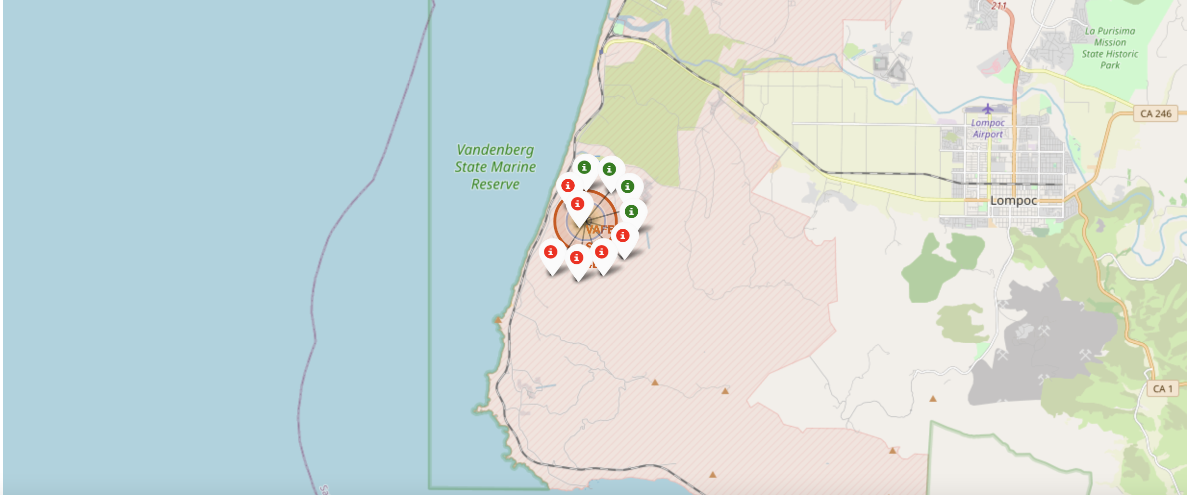
FOLIUM
Each launch site is marked on the map, showing both successful and failed missions.
When you zoom in on a specific site, you’ll notice green and red markers:
🟢 Green markers indicate successful launches
🔴 Red markers indicate failed launches
This visual helps clearly compare the performance of each site based on past outcomes.

Slide 26
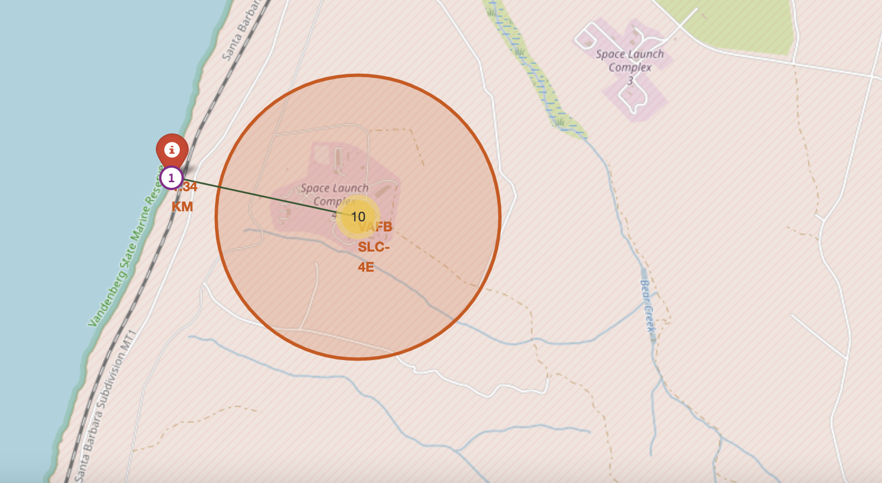
FOLIUM
We calculated the distances from each launch site to nearby key locations including the nearest city, railway line, and highway.
The image below highlights one such example: It shows the distance from the VAFB SLC-4E launch site to the nearest coastline.

Slide 27

DASH

Slide 28
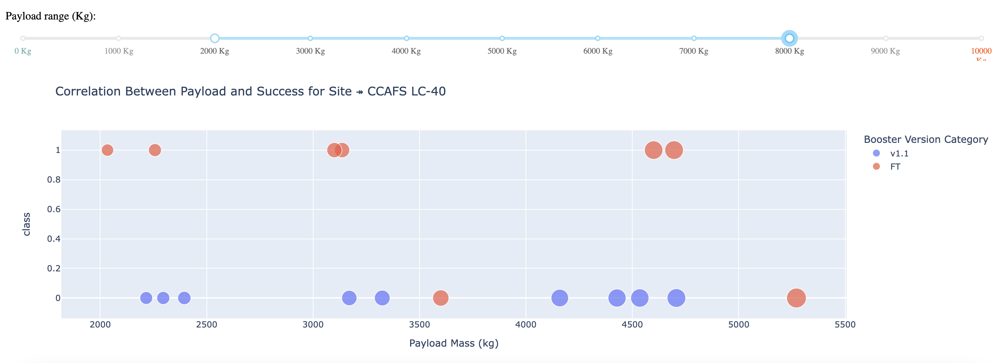
DASH
The scatterplot below displays the data when the payload mass is filtered between 2000 kg and 8000 kg.
In this plot:
Class 0 = Failed Launches (🔴)
Class 1 = Successful Launches (🟢)
This visualization helps in understanding how payload weight may relate to the launch outcome

Slide 29

PREDICTIVE ANALYSIS
Logistic Regression Results
Best Score from GridSearchCV: 0.846
Accuracy on Test Data: 0.833
Confusion Matrix:

Slide 30
PREDICTIVE ANALYSIS
Decision Tree Results
Best Score from GridSearchCV: 0.889
Accuracy on Test Set: 0.833
Confusion Matrix:

Slide 31
PREDICTIVE ANALYSIS
Support Vector Machine (SVM) Results
Best Score from GridSearchCV: 0.848
Accuracy on Test Set: 0.833
Confusion Matrix:

Slide 32
PREDICTIVE ANALYSIS
K-Nearest Neighbors (KNN) Results
Best Score from GridSearchCV: 0.848
Accuracy on Test Set: 0.833
Confusion Matrix:

Slide 33
PREDICTIVE ANALYSIS
Model Comparison & Ranking
All four machine learning models Logistic Regression, SVM, Decision Tree, and KNN produced identical accuracy scores (83.3%) and confusion matrices when evaluated on the test set.
Since the accuracy was the same across models, we used their GridSearchCV best scores to determine overall performance. Based on those scores, the models are ranked from best to worst as follows:
Decision Tree: Best Score: 0.889
K-Nearest Neighbors (KNN): Best Score: 0.848
Support Vector Machine (SVM): Best Score: 0.848
Logistic Regression : Best Score: 0.846
This ranking highlights the Decision Tree model as the top performer when hyperparameters are optimized.

Slide 34
PREDICTIVE ANALYSIS
The core objective of this project was to predict the success or failure of the Falcon 9 rocket’s first-stage landing. This task holds significant value, as a successful landing greatly reduces SpaceX’s launch expenses by enabling reusability of rocket components.
To tackle this, we explored various launch-related features such as payload mass, orbit type, and others to understand their impact on mission outcomes.
We applied multiple machine learning algorithms on historical launch data to identify meaningful patterns that could improve future predictions.
Out of all the models, the Decision Tree classifier emerged as the top performer, showing the highest predictive accuracy among the approaches tested.

Slide 35
Thank You

